Slide 1
Inflation and Monetary Policy
Rajiv Sethi and the CORE Team
November 29, 2021

Slide 2
Overview
Real and Nominal GDP
Measuring Price Changes
The GDP Deflator
The Consumer Price Index
The Phillips Curve
Inflation expectations
Reading: The Economy Unit 13.8, Unit 15 Introduction to 15.13
Focus on historical and empirical parts of Unit 15

Slide 3
Measuring Inflation

Slide 4
Real and Nominal GDP
Nominal GDP: value of goods/services at current prices
Real GDP: value of goods/services at constant prices
Base year determines which prices are used
GDP Deflator: Ratio of Nominal to Real GDP
Inflation Rate: Growth rate of GDP deflator
Note: inflation measure is sensitive to choice of base year
What is the value of the GDP deflator in the base year?

Slide 5
Example
Consider two years, 2018 and 2019
Three goods: cloth, wine, diamonds
2018 outputs: 10,000 cloth, 8,000 wine, 100 diamonds
2018 prices: $10 cloth, $10 wine, $1,000 diamonds
2019 outputs: 10,500 cloth, 7,500 wine, 105 diamonds
2019 prices: $9 cloth, $12 wine, $1,200 diamonds
What is Nominal GDP in each year and its growth rate
What is Real GDP in each year and it’s growth rate?
Does it matter which year we use as base year?

Slide 6
Year | 2018 | 2019
Cloth | 10,000 | 10,500
Wine | 8,000 | 7,500
Diamonds | 100 | 105
Cloth Price | $10 | $9
Wine Price | $10 | $12
Diamond Price | $1,000 | $1,200
NGDP | $280,000 | $310,500
NGDP Growth |  | 10.9%
RGDP (2018 Base) | $280,000 | $285,000
RGDP Growth |  | 1.8%
RGDP (2019 Base) | $306,000 | $310,500
RGDP Growth |  | 1.5%
Deflator (2018 Base) | 1.00 | 1.09
Inflation Rate |  | 8.9%
Deflator (2019 Base) | 0.92 | 1.00
Inflation rate |  | 9.3%

Slide 7
Consumer Price Index
For wage negotiations, overall inflation rate less relevant
Alternative approach: consumer price index
Based on a basket of goods/services
Growth in CPI gives alternative measure of inflation
Suppose basket is: 10 cloth, 5 wine
What is the CPI inflation rate in our example?

Slide 8
Year | 2018 | 2019
Cloth | 10,000 | 10,500
Wine | 8,000 | 7,500
Diamonds | 100 | 105
Cloth Price | $10 | $9
Wine Price | $10 | $12
Diamond Price | $1,000 | $1,200
NGDP | $280,000 | $310,500
NGDP Growth |  | 10.9%
RGDP (2018 Base) | $280,000 | $285,000
RGDP Growth |  | 1.8%
RGDP (2019 Base) | $306,000 | $310,500
RGDP Growth |  | 1.5%
Deflator (2018 Base) | 1.00 | 1.09
Inflation Rate |  | 8.9%
Deflator (2019 Base) | 0.92 | 1.00
Inflation rate |  | 9.3%
CPI Cloth Basket | 10 | 10
CPI Wine Basket | 5 | 5
CPI Diamond Basket | 0 | 0
Basket Price | $150 | $150
CPI Inflation Rate |  | 0.0%

Slide 9
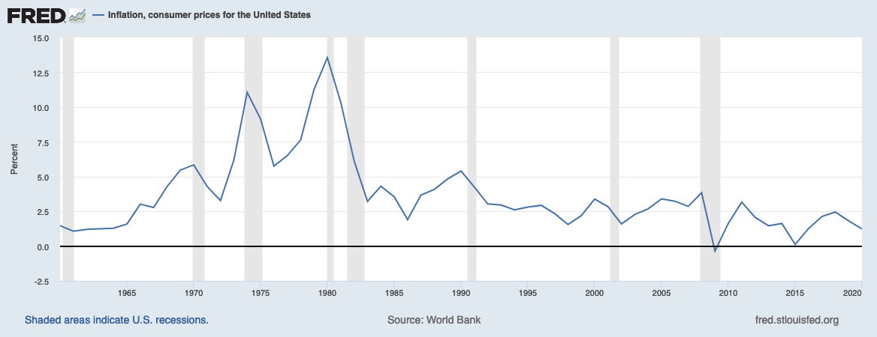
View Latest Data
Notes:
Source: World Bank Release: World Development Indicators Units: Percent, Not Seasonally Adjusted Frequency: Annual Inflation as measured by the consumer price index reflects the annual percentage change in the cost to the average consumer of acquiring a basket of goods and services that may be fixed or changed at specified intervals, such as yearly. The Laspeyres formula is generally used.International Monetary Fund, International Financial Statistics and data files. World Bank, Inflation, consumer prices for the United States [FPCPITOTLZGUSA], retrieved from FRED, Federal Reserve Bank of St. Louis; https://fred.stlouisfed.org/series/FPCPITOTLZGUSA, April 27, 2020.

Slide 10
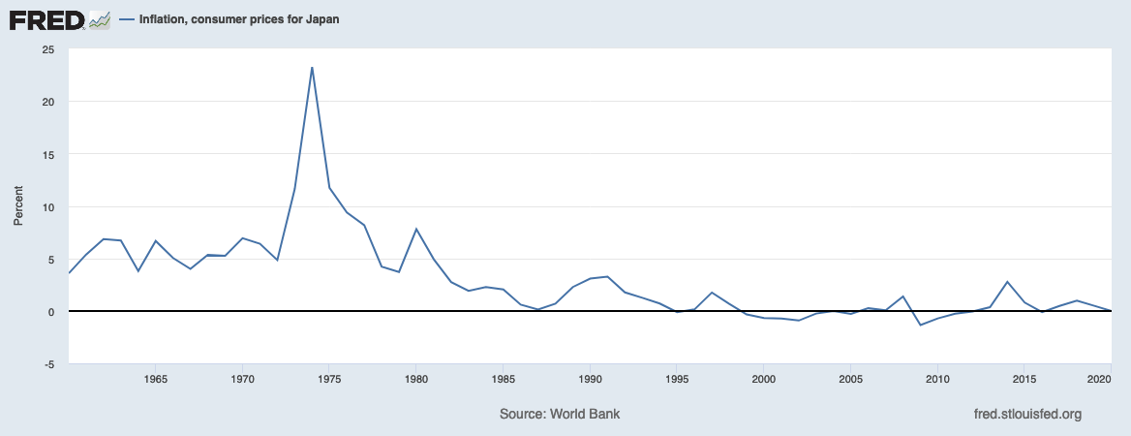
View Latest Data
Notes:
Source: World Bank Release: World Development Indicators Units: Percent, Not Seasonally Adjusted Frequency: Annual Inflation as measured by the consumer price index reflects the annual percentage change in the cost to the average consumer of acquiring a basket of goods and services that may be fixed or changed at specified intervals, such as yearly. The Laspeyres formula is generally used.International Monetary Fund, International Financial Statistics and data files. World Bank, Inflation, consumer prices for the United States [FPCPITOTLZGUSA], retrieved from FRED, Federal Reserve Bank of St. Louis; https://fred.stlouisfed.org/series/FPCPITOTLZGUSA, April 27, 2020.

Slide 11
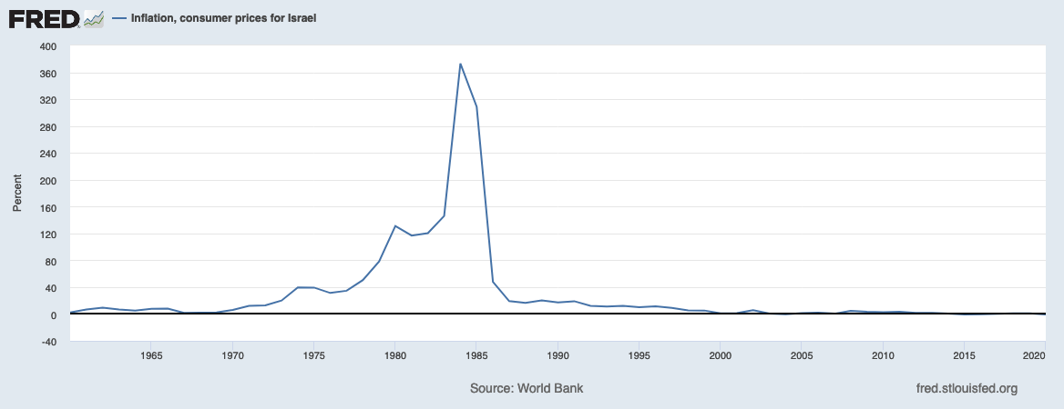
View Latest Data
Notes:
Source: World Bank Release: World Development Indicators Units: Percent, Not Seasonally Adjusted Frequency: Annual Inflation as measured by the consumer price index reflects the annual percentage change in the cost to the average consumer of acquiring a basket of goods and services that may be fixed or changed at specified intervals, such as yearly. The Laspeyres formula is generally used.International Monetary Fund, International Financial Statistics and data files. World Bank, Inflation, consumer prices for the United States [FPCPITOTLZGUSA], retrieved from FRED, Federal Reserve Bank of St. Louis; https://fred.stlouisfed.org/series/FPCPITOTLZGUSA, April 27, 2020.

Slide 12
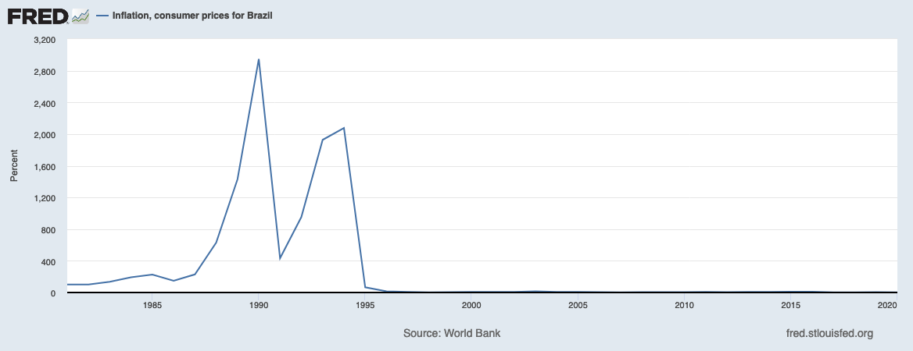
View Latest Data
Notes:
Source: World Bank Release: World Development Indicators Units: Percent, Not Seasonally Adjusted Frequency: Annual Inflation as measured by the consumer price index reflects the annual percentage change in the cost to the average consumer of acquiring a basket of goods and services that may be fixed or changed at specified intervals, such as yearly. The Laspeyres formula is generally used.International Monetary Fund, International Financial Statistics and data files. World Bank, Inflation, consumer prices for the United States [FPCPITOTLZGUSA], retrieved from FRED, Federal Reserve Bank of St. Louis; https://fred.stlouisfed.org/series/FPCPITOTLZGUSA, April 27, 2020.

Slide 13
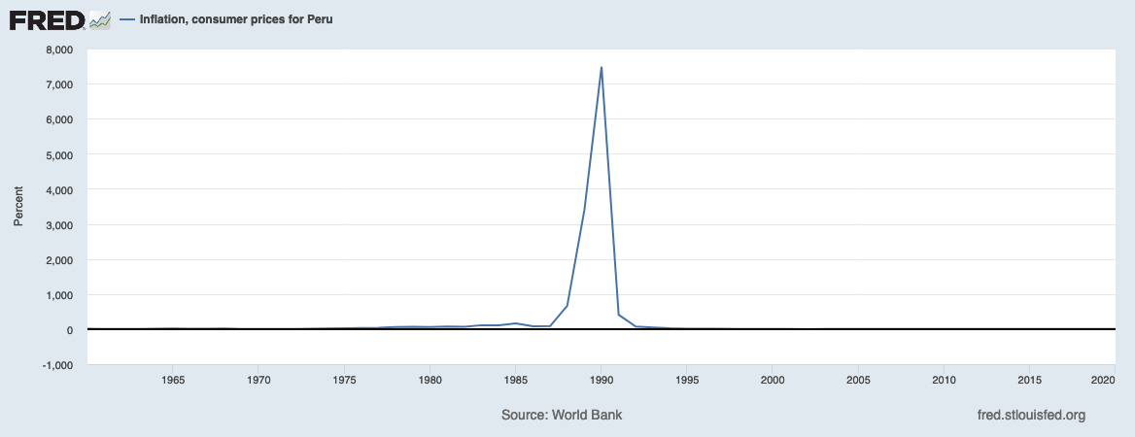
View Latest Data
Notes:
Source: World Bank Release: World Development Indicators Units: Percent, Not Seasonally Adjusted Frequency: Annual Inflation as measured by the consumer price index reflects the annual percentage change in the cost to the average consumer of acquiring a basket of goods and services that may be fixed or changed at specified intervals, such as yearly. The Laspeyres formula is generally used.International Monetary Fund, International Financial Statistics and data files. World Bank, Inflation, consumer prices for the United States [FPCPITOTLZGUSA], retrieved from FRED, Federal Reserve Bank of St. Louis; https://fred.stlouisfed.org/series/FPCPITOTLZGUSA, April 27, 2020.

Slide 14
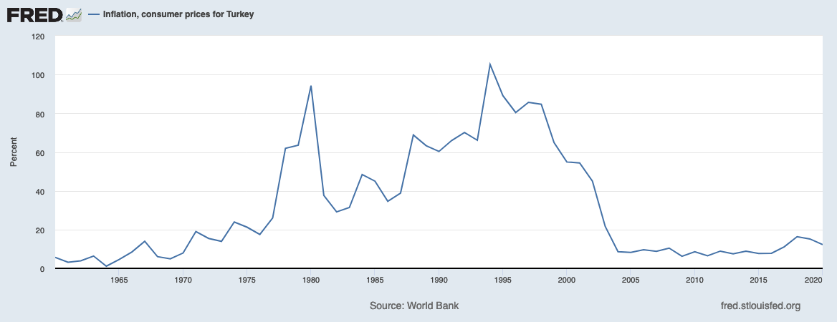
View Latest Data
Notes:
Source: World Bank Release: World Development Indicators Units: Percent, Not Seasonally Adjusted Frequency: Annual Inflation as measured by the consumer price index reflects the annual percentage change in the cost to the average consumer of acquiring a basket of goods and services that may be fixed or changed at specified intervals, such as yearly. The Laspeyres formula is generally used.International Monetary Fund, International Financial Statistics and data files. World Bank, Inflation, consumer prices for the United States [FPCPITOTLZGUSA], retrieved from FRED, Federal Reserve Bank of St. Louis; https://fred.stlouisfed.org/series/FPCPITOTLZGUSA, April 27, 2020.

Slide 15
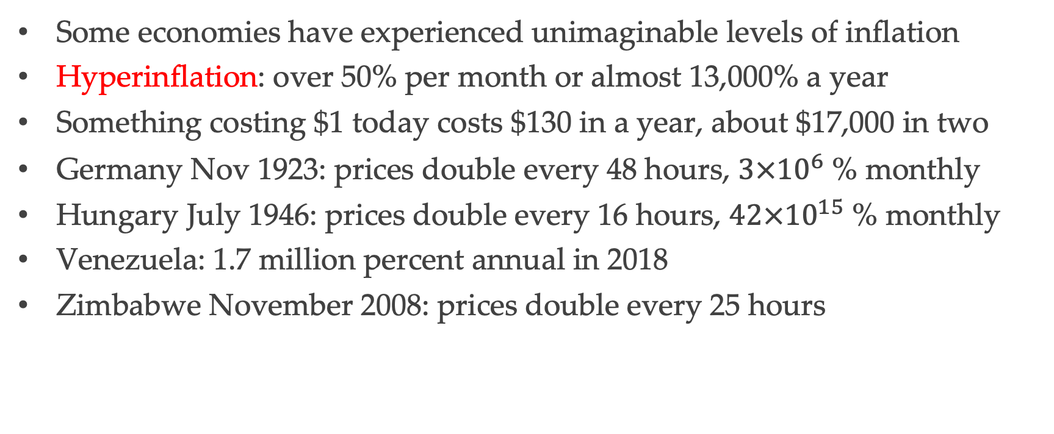
Hyperinflation
Some economies have experienced unimaginable levels of inflation
Hyperinflation: over 50% per month or almost 13,000% a year
Something costing $1 today costs $130 in a year, about $17,000 in two
Germany Nov 1923: prices double every 48 hours, $3×{10}^{6}$ % monthly
Hungary July 1946: prices double every 16 hours, $42×{10}^{15}$ % monthly
Venezuela: 1.7 million percent annual in 2018
Zimbabwe November 2008: prices double every 25 hours

Slide 16
Cost of Inflation
Many contracts denominated in nominal terms
Example: mortgages and other debt contracts
Also wages, salaries, rental agreements, other long term contracts
Costs of inflation depend on whether or not it is anticipated
Unanticipated inflation transfers resources from creditors to debtors
Unanticipated deflation has the opposite effect
Raises the real value of debt, can lead to insolvency

Slide 17
The Phillips Curve
Recall: Okun’s Law links output growth to change in unemployment
Unemployment is also linked to inflation
Original Phillip’s curve based on negative relationship
Low unemployment corresponds to high inflation
Next slide: careful with horizontal axis

Slide 18
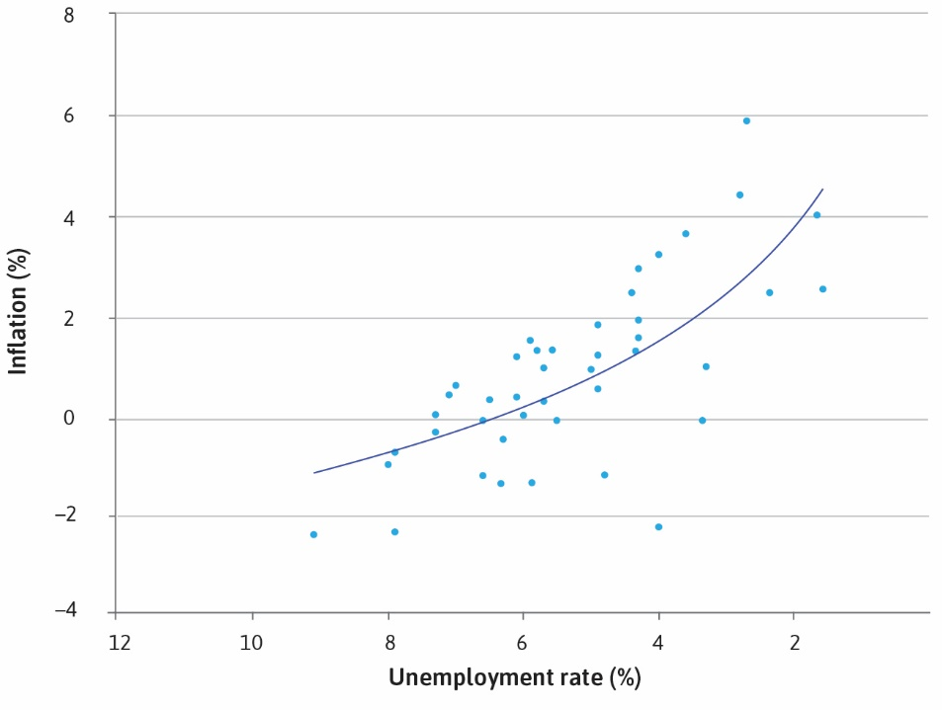

Slide 19
Unemployment and Inflation
Why might inflation be higher when unemployment is low?
One idea: conflict over income distribution
Greater bargaining power of workers to raise wages
Firms with market power then pass this on to consumers
This lowers real wages (adjusting for inflation)
Which leads to higher nominal wages, and so om…

Slide 20
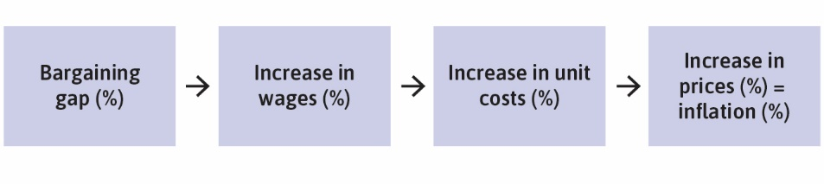

Slide 21
Policy Trade-offs
Original Phillips curve suggests policy trade-off
Lower unemployment can be sustained by tolerating higher inflation
Friedman critique: expectations will adjust so inflation is anticipated
In which case low unemployment will result in accelerating inflation
As expectations rise, Phillips curve will shift upwards

Slide 22
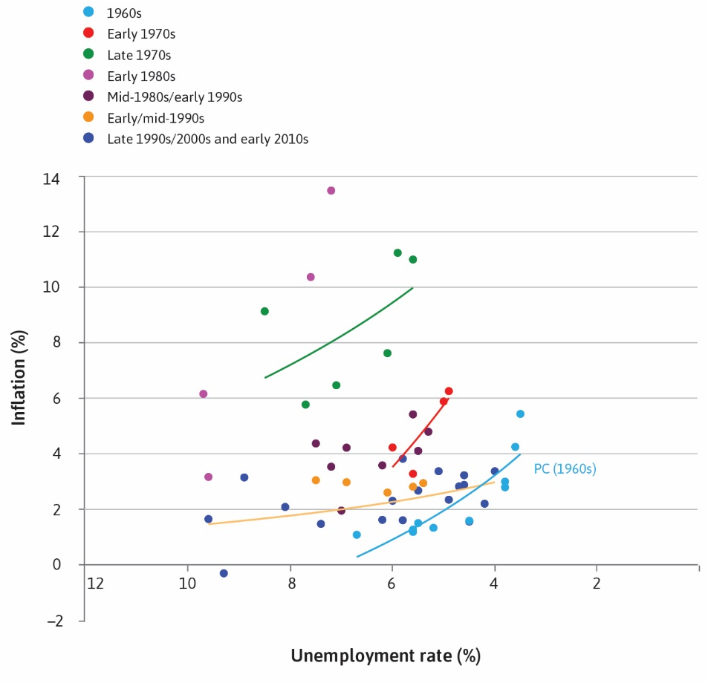

Slide 23
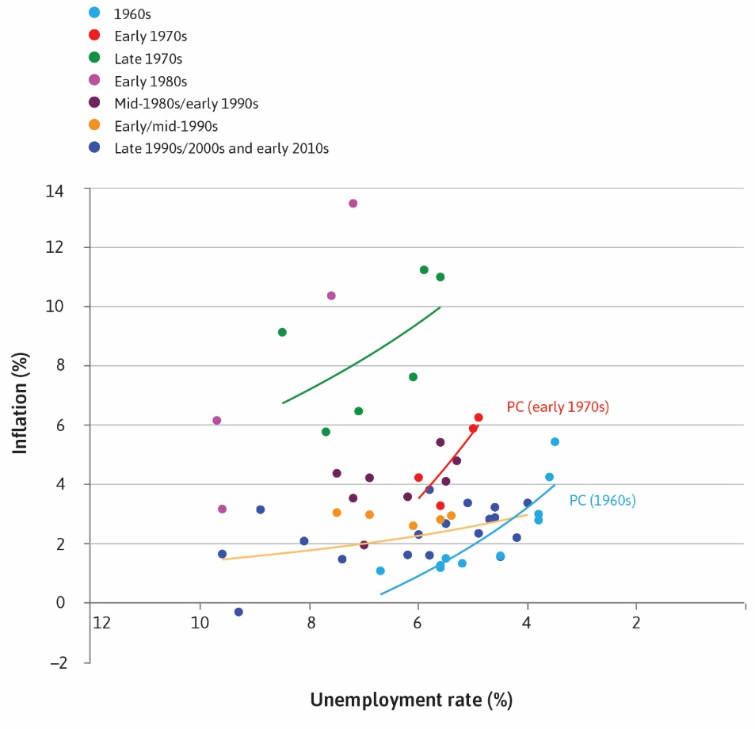

Slide 24
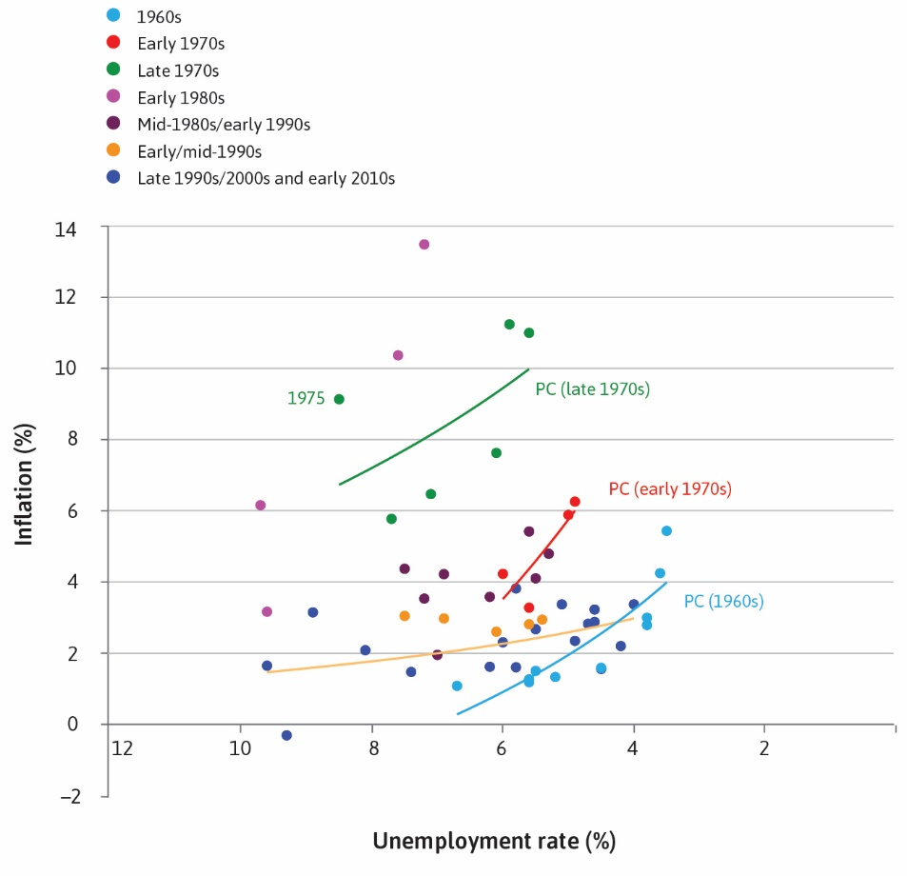

Slide 25
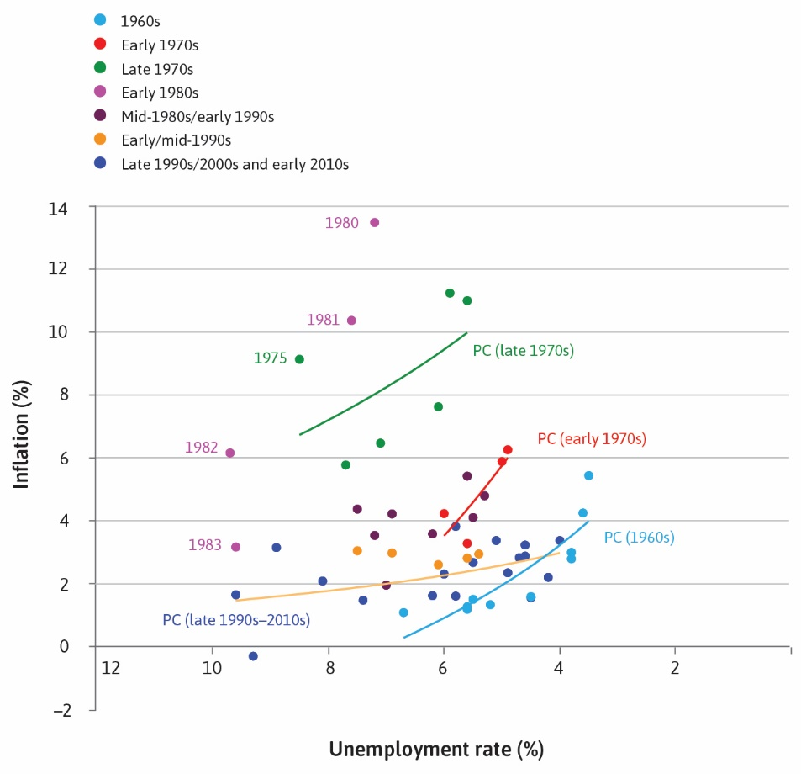

Slide 26
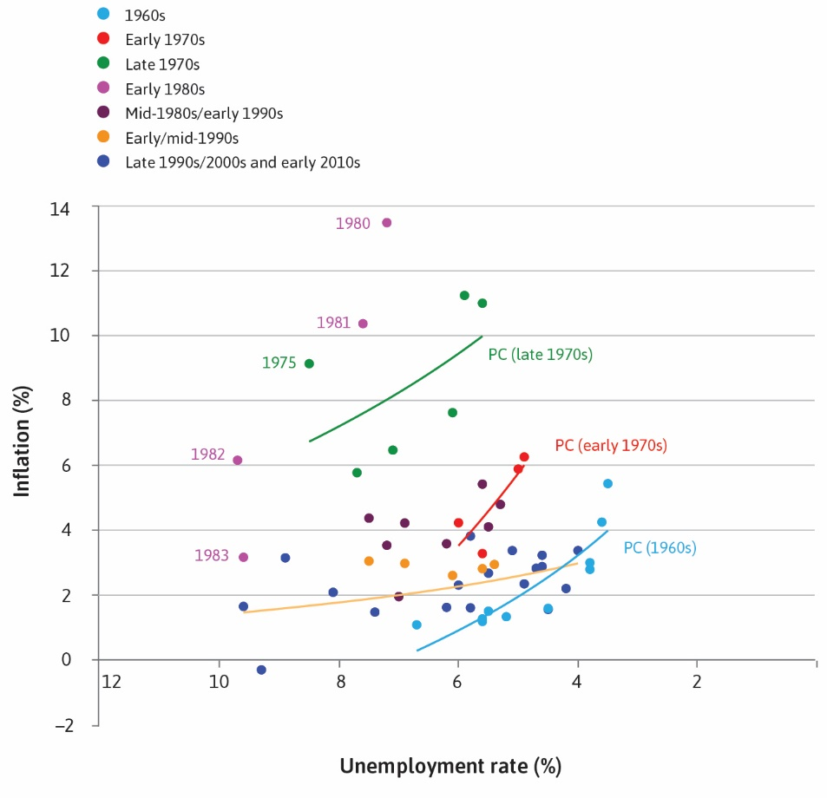

Slide 27
View Latest Data
Notes:
Source: World Bank Release: World Development Indicators Units: Percent, Not Seasonally Adjusted Frequency: Annual Inflation as measured by the consumer price index reflects the annual percentage change in the cost to the average consumer of acquiring a basket of goods and services that may be fixed or changed at specified intervals, such as yearly. The Laspeyres formula is generally used.International Monetary Fund, International Financial Statistics and data files. World Bank, Inflation, consumer prices for the United States [FPCPITOTLZGUSA], retrieved from FRED, Federal Reserve Bank of St. Louis; https://fred.stlouisfed.org/series/FPCPITOTLZGUSA, April 27, 2020.

Slide 28
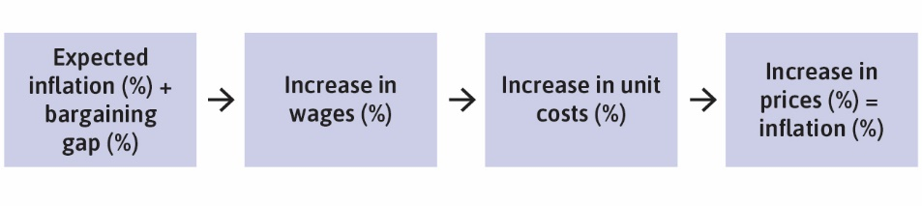

Slide 29
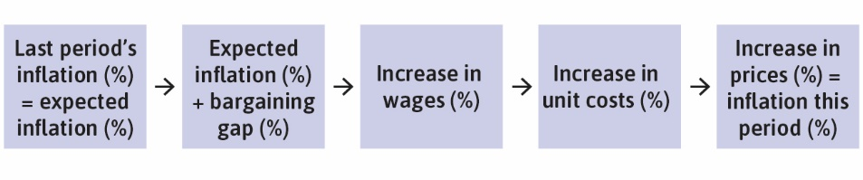

Slide 30
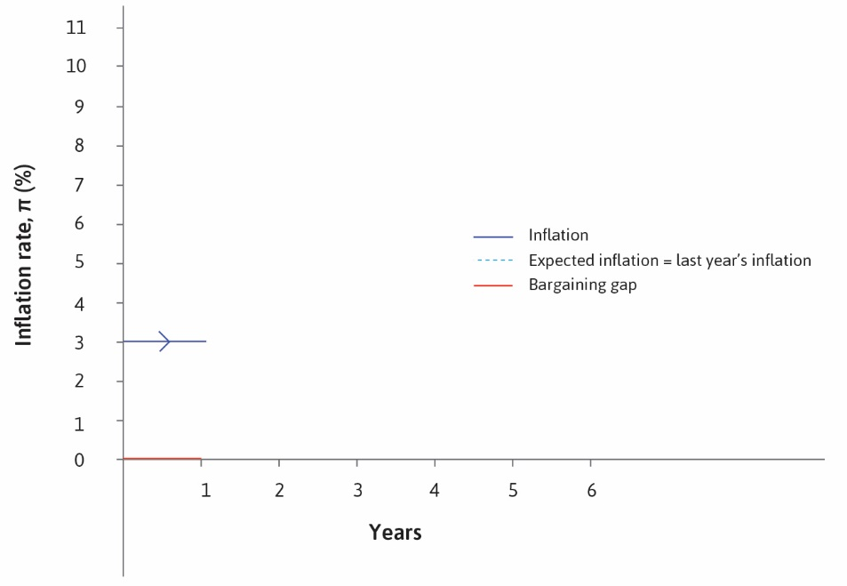

Slide 31
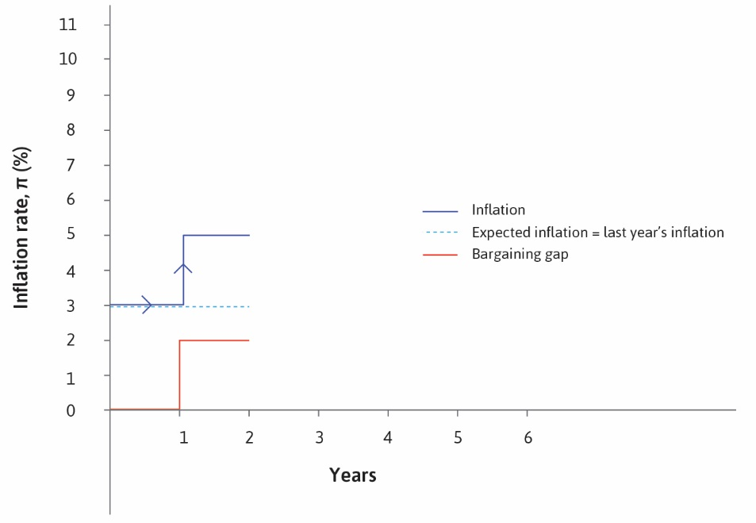

Slide 32
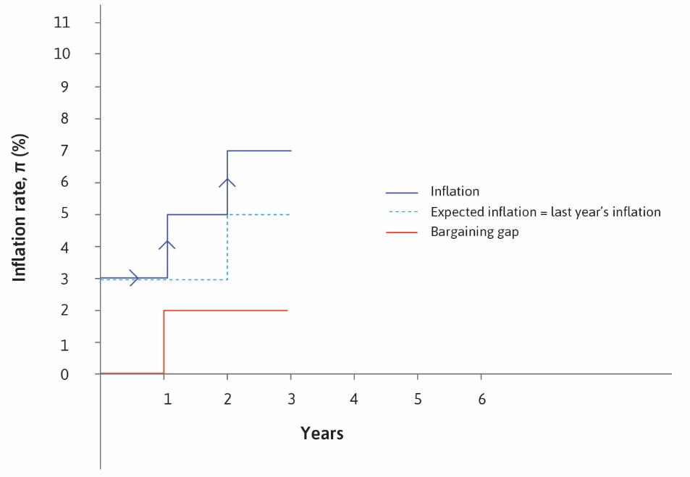

Slide 33
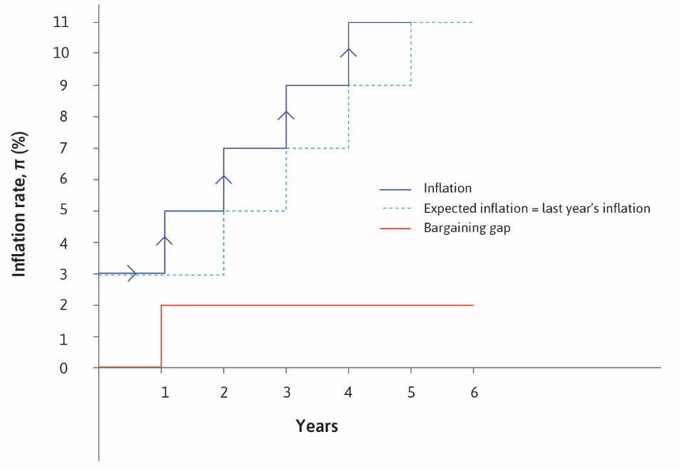

Slide 34
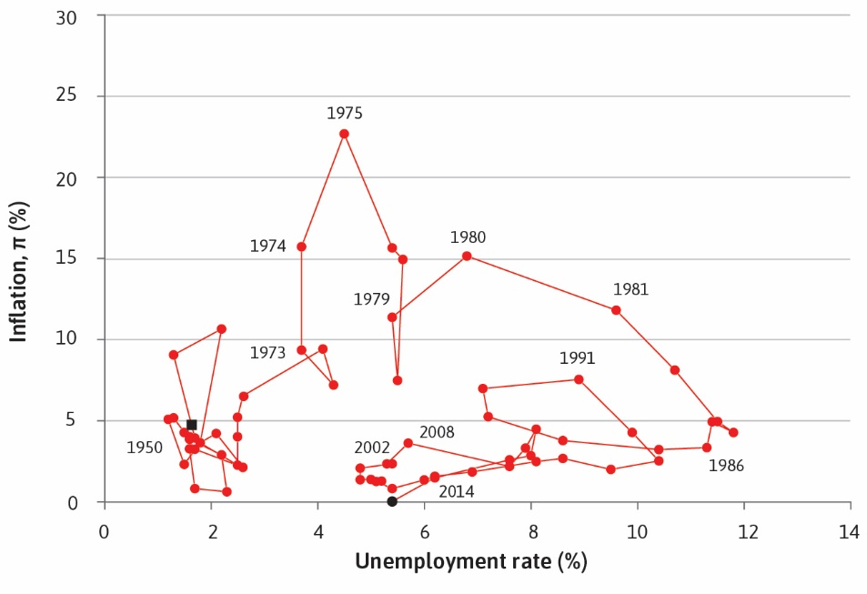

Slide 35
Monetary Policy
To bring inflation down, Fed generated high unemployment
Raised interest rates, reduce growth, increased unemployment
Lowered inflation, lowered expectations, lowered unemployment
Similarly, when economic activity is contracting and inflation is low
Fed lowers interest rates and raises growth to lower unemployment

Slide 36
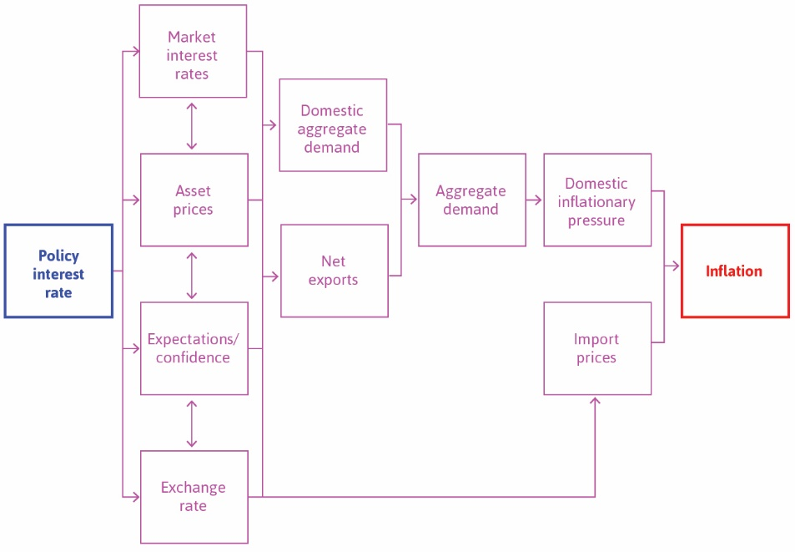

Slide 37
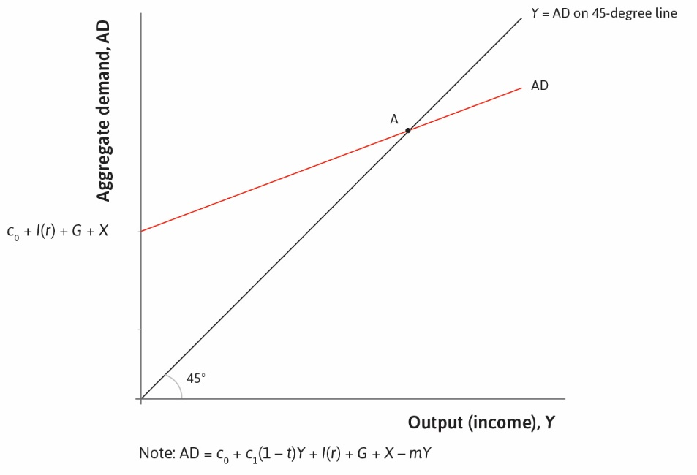

Slide 38
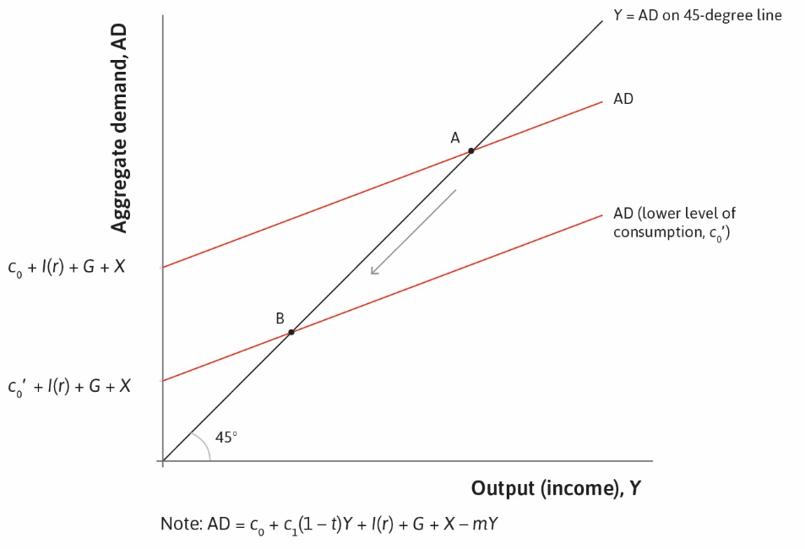

Slide 39
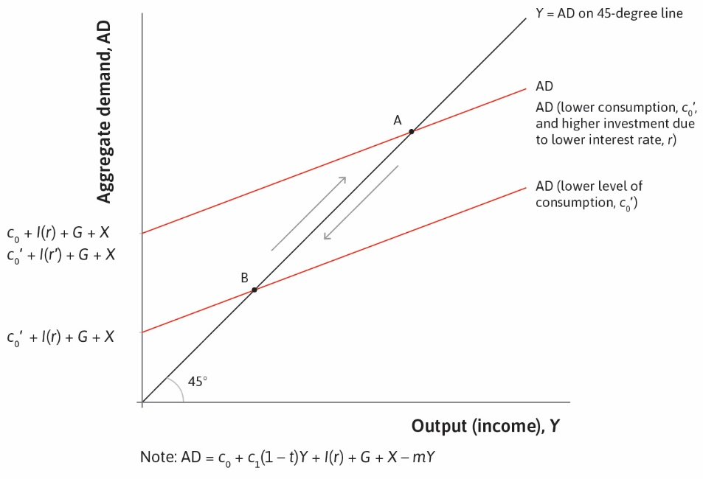

Slide 40
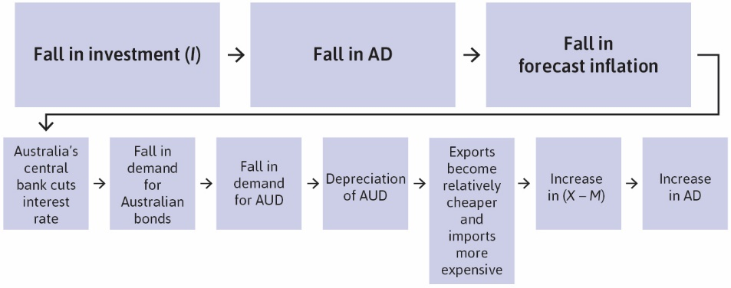

Slide 42


Slide 43
